Slide 1
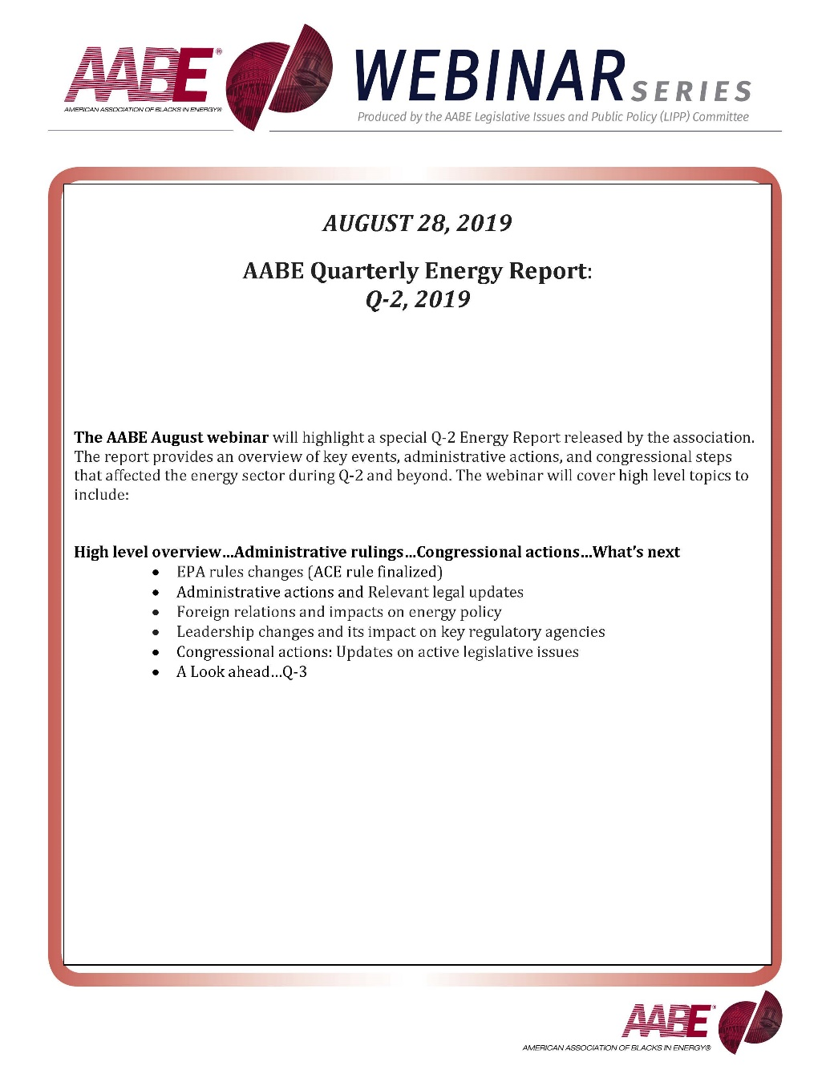

Slide 2
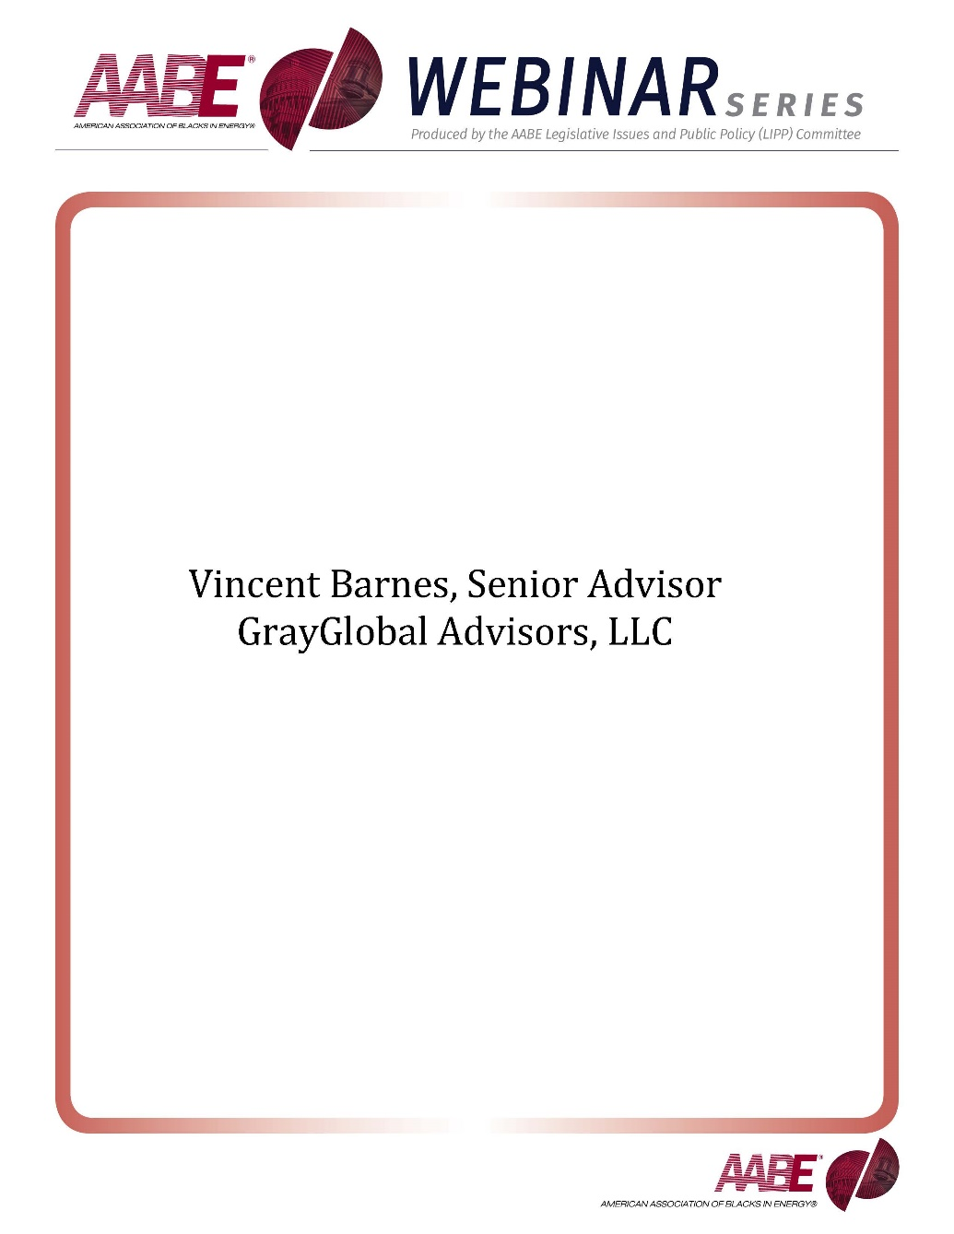

Slide 3
Q2 issue area review: Energy
An overview of key events, administrative actions, and congressional steps that affect the energy sector
June 28, 2019
Producer
American Association of Blacks in Energy

Slide 4
Roadmap
High level overview
Administrative actions
ACE rule finalized
E15 rule changed
Iran sanctions allowed to expire
Congressional actions
Hearings
Legislation
Look ahead
Notes:
Template slide

Slide 5
Roadmap
High level overview
Administrative actions
ACE rule finalized
E15 rule changed
Iran sanctions allowed to expire
Congressional actions
Hearings
Legislation
Look ahead
Notes:
Template slide

Slide 6
Recent US climate policy has centered around the Clean Power Plan and Affordable Clean Energy rule
Timeline of recent actions on US climate policy
2015
2016
2017
2019
EPA under President Obama issues the Clean Power Plan (CPP)
US Supreme Court halts implementation of the CPP
While the CPP is halted and ACE is not yet finalized, EPA has no formal plan to address CO2 emissions from power plants
EPA Administrator Scott Pruitt signs a formal proposal to repeal the CPP
DC Circuit Court places the case in temporary abeyance
The EPA issues the Affordable Clean Energy (ACE) rule, replacing the CPP
Looking ahead
Researchers from the nonprofit Resources for the Future predict ACE could increase CO2 emissions compared to no policy
Environmental groups are preparing to file legal challenges to ACE
Sources: Energy Information Agency, Natural Resources Defense Council, EPA, Resources for the Future, E&E News, Environmental Defense Fund.
Presentation Center | Slide last updated on: June 20, 2019
Notes:
Sources:
“EPA Finalizes Affordable Clean Energy Rule, Ensuring Reliable, Diversified Energy Resources while Protecting our Environment,” EPA, June 19, 2019, https://www.epa.gov/newsreleases/epa-finalizes-affordable-clean-energy-rule-ensuring-reliable-diversified-energy.
Amelia Keyes, Kathleen F. Lambert, Dallas Burtraw, Jonathan J. Buonocore, Jonathan I. Levy, and Charles T. Driscoll, “The Affordable Clean Energy Rule and the Impact of Emissions Rebound on Carbon Dioxide and Criteria Air Pollutant Emissions,” Resources for the Future, April 9, 2019, https://www.rff.org/publications/journal-articles/affordable-clean-energy-rule-and-impact-emissions-rebound/.
Pamela King and Jennifer Hijazi, “Trump admin's carbon rule faces legal war, E&E News, June 20, 2019, https://www.eenews.net/stories/1060635721.
Energy Information Agency, 2017.
“What is the Clean Power Plan?,” Natural Resources Defense Council, Sept. 29, 2017, https://www.nrdc.org/stories/how-clean-power-plan-works-and-why-it-matters.
“D.C. Circuit Keeps Clean Power Plan Litigation on Hold for Sixty More Days,” Environmental Defense Fund, Dec. 21, 2018.

Slide 7
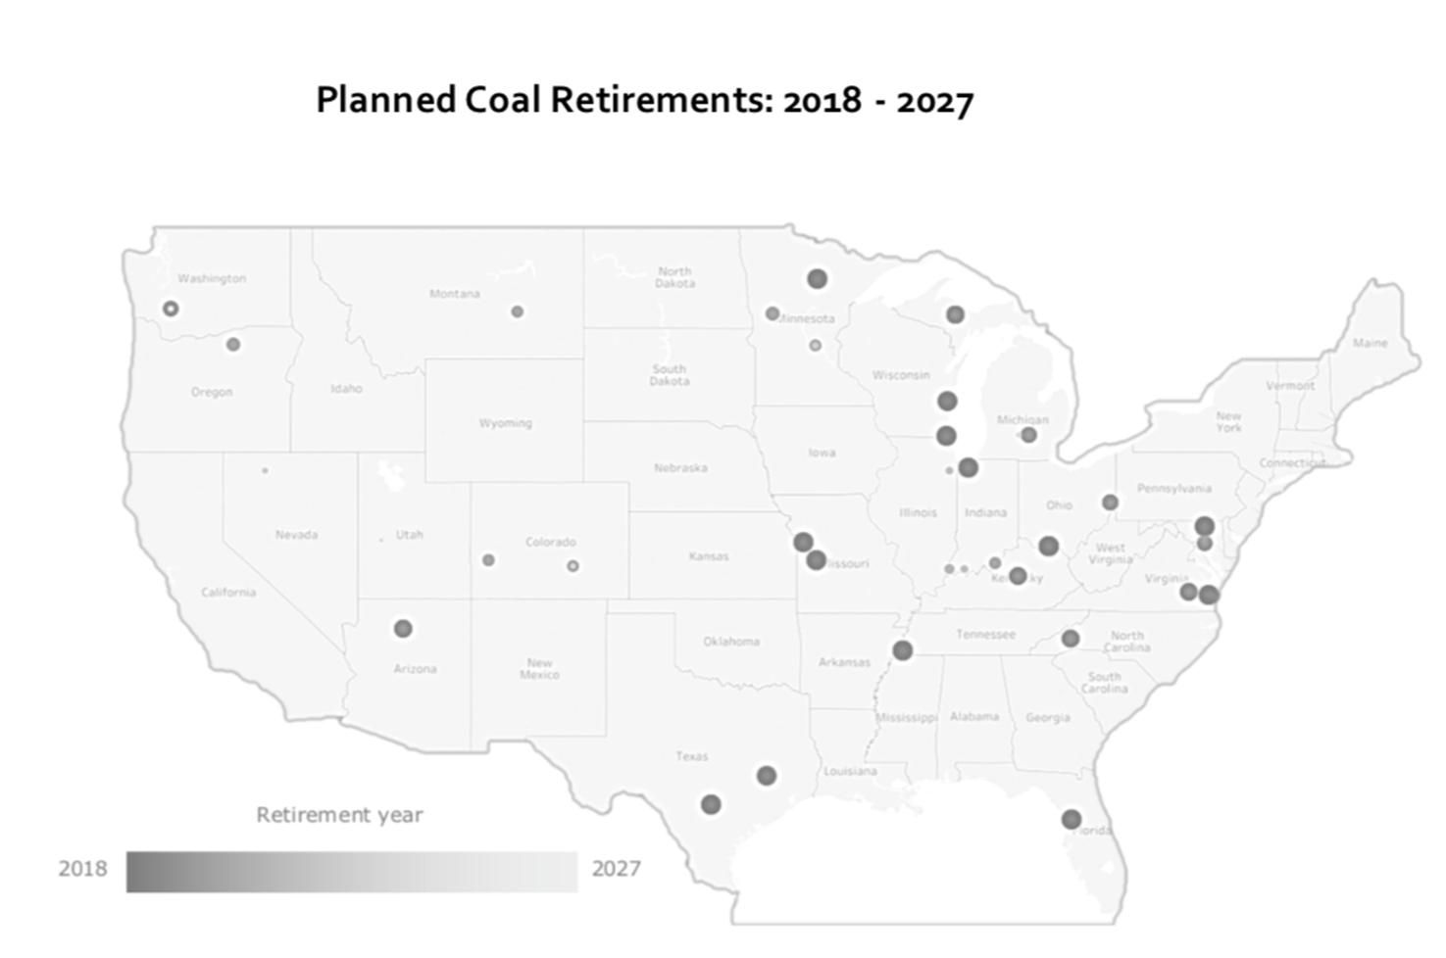

Slide 8
The EPA finalized a rule expanding ethanol sales
E15 will now be sold year-round
Proposal:
Proponents:
E15 is gasoline blended with up to 15 percent ethanol. It has been restricted during the summer, as studies show burning ethanol in warmer temperatures leads to ozone pollution and smog
“
Ending the nonsensical ban on summertime sales of higher blends of ethanol is a no-brainer and a big victory for Iowa, Midwest farmers and the country as whole.”
—Sen. Chuck Grassley (R-IA)
In June 2019, the EPA finalized a regulatory change allowing E15 sellers to use a waiver in the summer, effectively allowing year-round E15 sales
Opponents:
“
The administration needs to scrap this anti-consumer policy... Studies have shown that E15 gasoline can damage vehicle engines and fuel systems.”
The rule also included provisions to change the Renewable Identification Number (RIN) system to foster compliance in renewable fuel sales
—Frank Macchiarola, Vice President of American Petroleum Institute
Sources: EPA, Sen. Chuck Grassley, The Hill.
Presentation Center | Slide last updated on: June 28, 2019
Notes:
Sources:
Miranda Green, “EPA pushes forward plan to increase ethanol mix in gasoline,” The Hill, March 12, 2019.
“Final Rulemaking for Modifications to Fuel Regulations to Provide Flexibility for E15 and to Elements of the Renewable Identification Number Compliance System,” EPA, accessed June 24, 2019, https://www.epa.gov/renewable-fuel-standard-program/final-rulemaking-modifications-fuel-regulations-provide-flexibility.
“Grassley Praises Trump Action to Allow Year-Round Sales of Higher Blends of Ethanol,” Chuck Grassley, March 12, 2019.

Slide 9
US-Iran relations have impacted the global oil market
The US allowing sanctions waivers to expire could escalate bilateral tensions and threaten the oil supply of several countries
Actions:
Proponents:
In April 2019, the US announced it would allow sanctions waivers against Iran to expire
Sanctions threaten the energy supply of China, Japan, South Korea, Turkey, and India, which rely heavily on Iranian oil
“
Taken as a whole, these unprovoked attacks present a clear threat to international peace and security, a blatant assault on the freedom of navigation and an unacceptable campaign of escalating tension by Iran.”
Oil tankers have been attacked in the Persian Gulf and Gulf of Oman
American officials claim Iran is responsible and Pres. Trump has declared emergency in Iran
— Secretary of State Mike Pompeo
Opponents:
“
As a result of these developments, Iran could close the Strait of Hormuz, a major oil transport channel
This could result in war with the US and its allies
War with Iran…would have devastating consequences for the region and the world.”
— Sen. Elizabeth Warren (D-MA), via Twitter
Sources: Twitter, AP, BBC News, Reuters, CNBC, Arms Control Association, White House, The New York Times.
Presentation Center | Slide last updated on: June 28, 2019
Notes:
Sources:
@SenWarren, Twitter, June 28, 2019, https://twitter.com/SenWarren/status/1144627716592939010.
Jon Gambrell, “Tankers struck near Strait of Hormuz; US blames Iran,” AP, June 13, 2019, https://www.apnews.com/d67714ab8ac344a3b3af19cca1c20192.
“Iran oil: US to end sanctions exemptions for major importers,” BBC News. April 22, 2019, https://www.bbc.com/news/world-middle-east-48011496.
“Iran oil waivers: Is it about to become more expensive to fill my car?” BBC News. April 24, 2019.
Stephanie Kelly, “Oil prices slip as economic worries outweigh tanker tensions.” Reuters. June 16, 2019.
Tom DiChristopher, “Trump’s Iran nuclear deal review faces a dangerous path,” CNBC, April 25, 2017
Kelsey Davenport, “Timeline of Nuclear Diplomacy with Iran,” Arms Control Association, October 2017
President Donald Trump, “Remarks by President Trump on Iran Strategy,” The White House, October 13, 2017
“Iran profile – timeline,” BBC News, April 9, 2019
“Iran oil: US to end sanctions exemptions for major importers,” BBC, April 22, 2019
Vivian Yee, “Claim of Attacks on 4 Oil Vessels Raises Tensions in Middle East,” The New York Times, May 13, 2019
Helene Cooper, “The US Has Turned up Pressure on Iran. See the Timeline of Events,” The New York Times, June 14, 2019.

Slide 10
Timeline of the Trump administration’s Iran policy (May 2018-June 2019)
Trump announces he will pull the US out of the Iran deal; Secretary of State Pompeo announces sanctions lifted after the 2015 Iran deal will be re-imposed
The Trump administration announced that it will allow sanctions waivers to expire against Iran
Four oil tankers are attacked in the Persian Gulf; the Trump administration says Iran is mobilizing proxy groups
Two oil tankers in the Gulf of Oman are destroyed; American officials claim Iran is responsible
May 2018
April 2019
May 2019
June 13, 2019
June 2018
April 8, 2019
May 24, 2019
Iranian currency plummets to a historic low
The US officially designates the Iranian Revolutionary Guard as a foreign terrorist group
Trump declares emergency in Iran; sends troops and weapons to Middle East
Sources: CNBC; Arms Control Association; The White House; BBC News; The New York Times.
Presentation Center | Slide last updated on: June 17, 2019
Notes:
Sources:
Tom DiChristopher, “Trump’s Iran nuclear deal review faces a dangerous path,” CNBC, April 25, 2017
Kelsey Davenport, “Timeline of Nuclear Diplomacy with Iran,” Arms Control Association, October 2017
President Donald Trump, “Remarks by President Trump on Iran Strategy,” The White House, October 13, 2017
“Iran profile – timeline,” BBC News, April 9, 2019; “Iran oil: US to end sanctions exemptions for major importers,” BBC, April 22, 2019
Vivian Yee, “Claim of Attacks on 4 Oil Vessels Raises Tensions in Middle East,” The New York Times, May 13, 2019
Helene Cooper, “The US Has Turned up Pressure on Iran. See the Timeline of Events,” The New York Times, June 14, 2019.

Slide 11
Iran sanctions waivers expired on May 2, 2019
Waivers expired:
Significance of the 2018 waivers
China, Japan, South Korea, Turkey, and India did not stop buying oil from Iran after they received sanctions waivers in 2018
Iran sanctions threaten the oil supply of these countries
Turkey and China, which purchase roughly 50% of all Iranian oil exports, have indicated discontent with the prospect of no longer buying Iranian oil
1.3 million
barrels of oil exported daily by Iran to buyers like India, China, and South Korea
Consequences of the waivers expiring
Oil prices have fallen by 20% since April 2019
Tensions in the Middle East, supply problems in Venezuela and Libya, and lower Chinese demand due to the trade war with the US have all affected global demand
If Iran were to close the Strait of Hormuz, through which 28.9% of all maritime oil trade travels, it could result in war with the US and its allies
China
South Korea
India
Turkey
According to the Financial Times
47.6%
Of 2018 Iranian revenue came from oil
Taiwan
Japan
Italy
Greece
According to OPEC
Sources: BBC News, Reuters.
Presentation Center | Slide last updated on: June 17, 2019
Notes:
Sources:
“Iran oil: US to end sanctions exemptions for major importers,” BBC News. April 22, 2019.
“Iran oil waivers: Is it about to become more expensive to fill my car?” BBC News. April 24, 2019.
Stephanie Kelly, “Oil prices slip as economic worries outweigh tanker tensions.” Reuters. June 16, 2019.

Slide 12
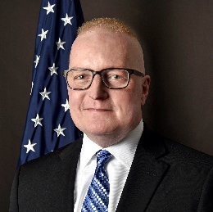
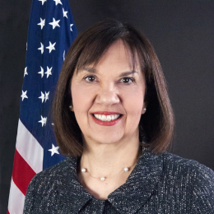
The White House has not yet nominated FERC replacements
In January, FERC Chair Kevin McIntyre passed away and Commissioner Cheryl LaFleur announced her departure
Kevin McIntyre (R):
biography
Cheryl LaFleur (D):
biography
What comes next?
McIntyre was confirmed as FERC chairman in November of 2017
He was diagnosed with brain cancer in 2017, voluntarily stepped down from chairman to commissioner in Oct. of 2018, and passed away on Jan. 2, 2019
At FERC, McIntyre rejected a DOE proposal to subsidize nuclear and coal power plants, worked on cutting environmental permitting time for large infrastructure projects, and led reviews of US grid resilience and natural gas pipeline certification
LaFleur was confirmed in 2010
In Jan. of 2019, Senate Democrats informed her that she would not be re-nominated and she announced via Twitter that she would not seek a third FERC term
She is FERC’s longest-serving member and the only regulator with experience at an electric utility
She announced in June that she will leave at the end of August 2019
No political party can hold more than three of FERC’s five seats
President Trump must nominate a Democrat and a Republican to fill the two empty seats
Sources: Utility Dive, E&E Mews, FERC, Green Tech Media, Twitter.
Presentation Center | Slide last updated on: June 28, 2019
Notes:
Sources:
Gavin Bade, “FERC’s LaFleur to step down after push from Senate Democrats,” Utility Dive, updated Feb. 1, 2019.
Rod Kuckro, “Commissioner Kevin McIntyre dies,” E&E News, Jan. 3, 2019.
“Commissioner Cheryl A. LaFleur Biography,” FERC.
@CLaFleurFERC, Twitter, June 20, 2019, https://twitter.com/CLaFleurFERC/status/1141783991982395393.
Jeff St. John, “Trump Names Chatterjee as FERC Chairman to Replace Ailing McIntyre,” Green Tech Media, Oct. 25, 2018.

Slide 13
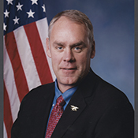
David Bernhardt was confirmed as Department of the Interior Secretary on April 11, 2019
Bernhardt had served as Acting Secretary after former Secretary Ryan Zinke resigned
Previous Secretary Ryan Zinke: biography
Current Secretary David Bernhardt: biography
Ryan Zinke was confirmed to the position in 2017
Zinke announced his resignation in December of 2018, as he faced federal ethics investigations into alleged misuse of funds and conflicts of interest
As Secretary, he worked to roll back environmental regulations and promote US energy development
Zinke served in Congress before being selected as DOI Secretary
Acting DOI Secretary David Bernhardt was confirmed as Secretary on April 11, 2019
Before his role as Secretary, he worked as an oil and gas lobbyist and served as a solicitor under George W. Bush and a Deputy Secretary at DOI
At his Senate confirmation hearing on March 27, he advocated advancing President Trump’s “energy dominance” agenda and was heavily questioned on potential conflicts of interest due to his previous lobbying work
At DOI, Bernhard has worked to expand offshore oil and gas leasing and roll back wildlife protections
Sources: The Washington Post, PBS.
Presentation Center | Slide last updated on: June 28, 2019
Notes:
Sources:
“Tracking how many key positions Trump has filled so far,” The Washington Post, updated June 24, 2019, https://www.washingtonpost.com/graphics/politics/trump-administration-appointee-tracker/database/?utm_term=.7627de0e30e4.
Darryl Fears & Juliet Eilperin, “Bernhardt’s past as a lobbyist casts shadow in acting interior secretary’s confirmation hearing,” The Washington Post, March 28, 2019
Ellen Knickmeyer, Matthew Brown, Jonathan Lemire, “Interior Secretary Zinke resigning, cites ‘vicious’ attacks,” PBS, Dec. 15, 2018.

Slide 14
Roadmap
High level overview
Administrative actions
ACE rule finalized
E15 rule changed
Iran sanctions allowed to expire
Congressional actions
Hearings
Legislation
Look ahead
Notes:
Template slide

Slide 15
Both the House and Senate held energy hearings in Q2
June 4th: Full committee hearing to examine expanded deployment of grid-scale energy storage
Who:
Key takeaways
Senate Energy and Natural Resources Chairman Lisa Murkowski (R-AK) called for expert witnesses to examine opportunities for the expanded deployment of grid-scale energy storage, which would ensure energy access during natural disasters or other outages. Witnesses from the Joint Center for Energy Storage Research and various utilities and energy companies testified.
Witnesses urged the federal government to increase its role in developing energy storage technology. Proposed solutions included cross-agency collaboration, streamlining permitting, providing tax credits, federal and state government coordination, and increased funding for research and development.
May 1st: Hearing on “The state of pipeline safety and security in America"
Who:
Key takeaways
House Energy & Commerce Chair Frank Pallone (D-NJ-6) and Energy Subcommittee Chair Bobby Rush (D-IL-1) held a hearing on pipeline safety and security. Witnesses from the Pipeline and Hazardous Materials Safety Administration, Government Accountability Office, and pipeline industry groups testified. The Transportation Security Administration, the leading oversight authority for pipeline security, declined to send a representative to the hearing.
The hearing focused on GAO’s findings that the pipeline security branch of TSA is understaffed and underprepared to mitigate physical and cybersecurity threats to the pipeline system.
Sources: Senate Energy & Commerce Committee, Daily Energy Insider, ZD Net, House Energy & Commerce Committee, Government Accountability Office, Houston Chronicle.
Presentation Center | Slide last updated on: June 28, 2019
Notes:
Sources:
James Osborne, “ TSA under scrutiny over pipeline security failures,” Houston Chronicle, May 10, 2019, https://www.houstonchronicle.com/business/energy/article/TSA-under-scrutiny-over-pipeline-security-failures-13835558.php.
“Actions Needed to Address Weaknesses in TSA's Pipeline Security Program Management,” GAO, May 1, 2019, https://www.gao.gov/products/GAO-19-542T.
Catalin Cimpau, “Only six TSA staffers are overseeing US oil & gas pipeline security,” ZDNet, May 2, 2019, https://www.zdnet.com/article/only-six-tsa-staffers-are-overseeing-us-oil-gas-pipeline-security/.
“Hearing on ‘The state of pipeline safety and security in America’,” House Committee on Energy & Commerce, accessed June 28, 2109, https://energycommerce.house.gov/committee-activity/hearings/hearing-on-the-state-of-pipeline-safety-and-security-in-America.
Ed Roberts, “Experts eye government role in expansion of energy storage,” Daily Energy Insider, June 4, 2019, https://dailyenergyinsider.com/news/19746-experts-eye-government-role-in-expansion-of-energy-storage/.
“Full Committee Hearing to Examine Expanded Deployment of Grid-Scale Energy Storage,” US Senate Committee on Energy & Natural Resources, June 4, 2019, https://www.energy.senate.gov/public/index.cfm/hearings-and-business-meetings?ID=83B728AC-6708-40D6-9B96-CC007F5B5906.

Slide 16
Roadmap
High level overview
Administrative actions
ACE rule finalized
E15 rule changed
Iran sanctions allowed to expire
Congressional actions
Hearings
Legislation
Look ahead
Notes:
Template slide

Slide 17
Potential 2019 actions by the administration and Congress
Oil drilling
Energy infrastructure security
US-Iran relations
The Trump administration is attempting to increase oil and gas extraction on Western federal lands, in Alaska’s Arctic National Wildlife Refuge, and in federal waters
Drilling plans will likely be contested in court
The TSA has agreed to take action on the GAO’s recommendations
The Department of Energy and FERC may release additional rules in 2019 to strengthen the electric grid
The Trump administration may declare war on Iran or engage in future negotiations over sanctions, which would impact global oil supply
Though the Senate did not achieve the requisite votes on June 28, Congress may propose additional measures to restrict President Trump’s ability to intervene in Iran
Sources: E&E News, Hosuton Chronicle, GAO, The New York Times, The Washington Post.
Presentation Center | Slide last updated on: June 28, 2019
Notes:
Sources:
Kelsey Brugger, “Trump’s energy agenda hits pitfalls in ‘slog to the finish’,” E&E News, March 26, 2019.
James Osborne, “ TSA under scrutiny over pipeline security failures,” Houston Chronicle, May 10, 2019, https://www.houstonchronicle.com/business/energy/article/TSA-under-scrutiny-over-pipeline-security-failures-13835558.php.
“Actions Needed to Address Weaknesses in TSA's Pipeline Security Program Management,” GAO, May 1, 2019, https://www.gao.gov/products/GAO-19-542T.
Blake Sobczak, “Experts assess damage after first cyberattack on U.S. grid,” E&E News, May 6, 2019, https://www.eenews.net/stories/1060281821.
Helene Cooper, “The US Has Turned up Pressure on Iran. See the Timeline of Events,” The New York Times, June 14, 2019.
Karoun Demirjian, “Senate falls short in vote to restrain Trump on Iran,” The Washington Post, June 28, 2019, https://www.washingtonpost.com/world/national-security/senate-falls-short-in-vote-to-restrain-trump-on-iran/2019/06/28/92030b00-99a8-11e9-916d-9c61607d8190_story.html?utm_term=.066212b0d409.

